Slide 1

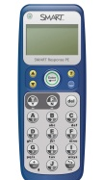
Recorder Karate
White Belt
Red Belt
Yellow Belt
Black Belt
Orange Belt
1
Challenge
Bead
Purple Belt
2
Challenge
Bead
Blue Belt
3
Challenge
Bead
Green Belt
4
Challenge
Bead
Brown Belt
**Classroom chart to track belts **Smart Response test

Slide 2

AFL Recorder Learning Targets
I can read treble clef music notation and accurately sing the pitches.
I can name and accurately perform the following rhythm notes values: eighth notes, quarter notes, dotted quarter notes, half notes, dotted half notes, whole notes, quarter rests, and half rests.
I can interpret a fingering chart and demonstrate proper fingerings.
I can memorize and demonstrate proper fingerings on the recorder.
I can read music and perform with proper technique the following songs with three mistakes or less to earn recorder karate belts at the highest possible level.
Novice Level
Hot Cross Buns
Merrily We Roll Along
Star Light, Star Bright
Proficient Level
Indian Chant
Rockin’
Canoe Song
Intermediate Level
When the Saints
Jingle Bells
Ode to Joy
Advanced Level
Fun wa nia la fia
Baroque Song
Old Brass Wagon
Sourwood Mountain

Slide 3
Rhythm Review

Slide 4









Name the Symbol & the Number of Beats
Review
quarter note
1 beat
dotted quarter note
1 ½ beats
eighth notes
½ beat each
eighth note
½ beat
4-A
4-B
4-C
5-A
5-B
5-C
half note
2 beats
dotted half note
3 beats
whole note
4 beats
quarter rest
1 silent beat
half rest
2 silent beats

Slide 5
Treble Clef Pitch Review
4-A
4-B
4-C
5-A
5-B
5-C

Slide 6

Notes in Spaces
Review
treble clef
staff
F
A
C
E
Remember: Face rhymes with Space.

Slide 7
Notes Around Lines
Review
treble clef
staff
E
G
B
D
F
very
ood
oy
oes
ine
Remember: Fine rhymes with Line.

Slide 8

It’s Time to Play

Slide 9
How to Play . . .
Position of Instrument
Air Stream
Hand Position-
LH Finger B
RH Thumb Behind Hole #4
Where to Place the Instrument in Mouth
Let’s Play our first note- B
Tonguing
Let’s Play A
Mix it Up- Play A & B
Let’s Play G
Mix it Up-Play A, B, & G
Let’s Learn Our First Song!
Notes:
This page is teacher led through demonstration and guided practice.

Slide 10

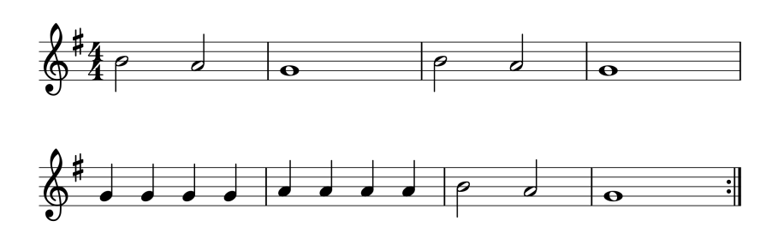

Hot Cross Buns
CD #2
White Belt
English Folk Song
4-A
4-B
4-C
5-A
5-B
5-C

Slide 11
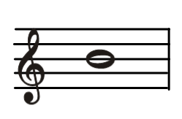
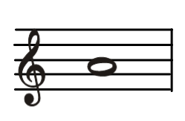
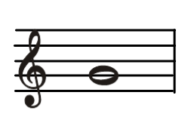
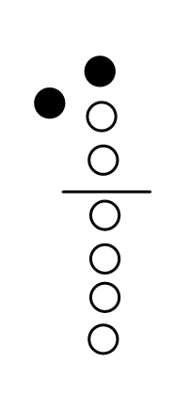
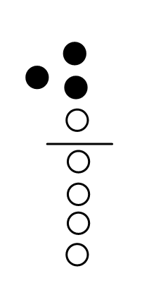
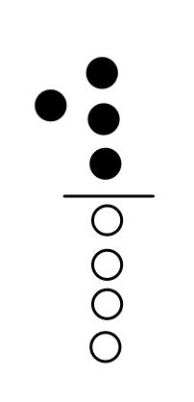
Fingering Charts
B, A, G
Memorize your fingerings

Slide 12
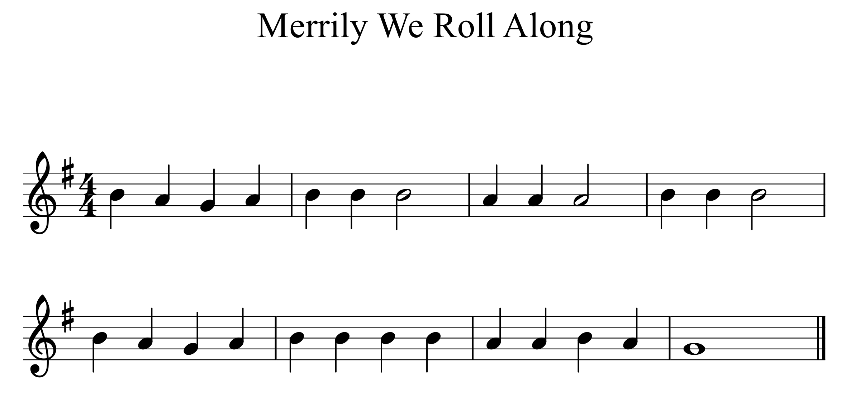
Merrily We Roll Along
CD #4
Yellow Belt
4-A
4-B
4-C
5-A
5-B
5-C

Slide 13

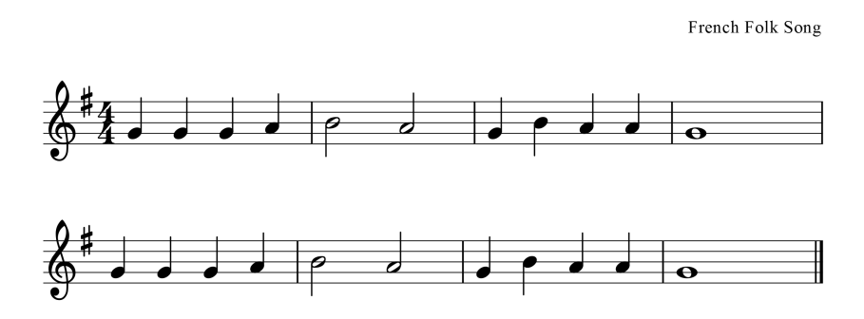

French Song
CD #3
Practice
legato
-smoothly & connected
_
_ _ _
_
_
simlie
4-A
4-B
4-C
5-A
5-B
5-C

Slide 14
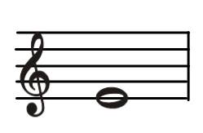
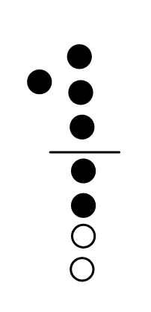
Fingering: E
Memorize your fingerings

Slide 15
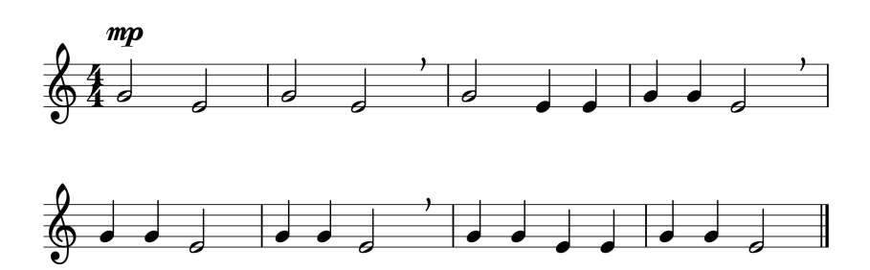

Star Light, Star Bright piano acc.
** Have your right hand ready.
Seat your fingers down to E.
Orange Belt
--mezzopiano, medium soft
--breath mark
4-A
4-B
4-C
5-A
5-B
5-C
fermata--

Slide 16
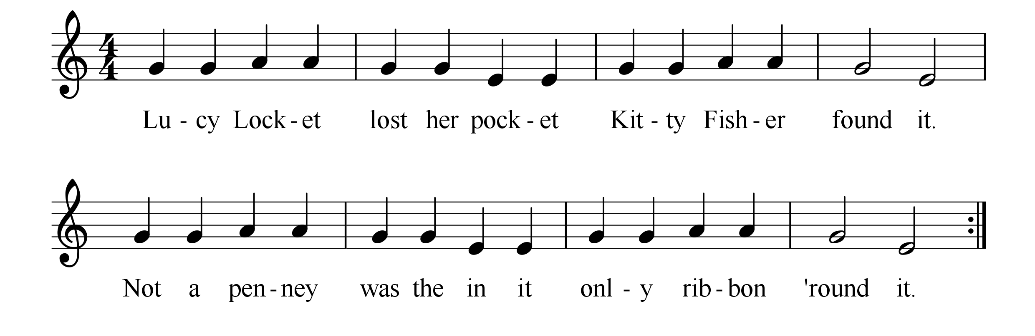
Lucy Locket
piano acc.
Practice
** Have your right hand ready.
Seat your fingers down to E.
4-A
4-B
4-C
5-A
5-B
5-C
there

Slide 17
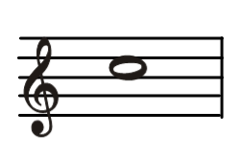
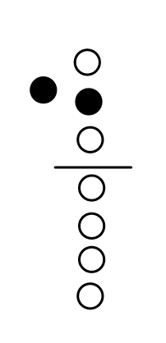
Fingering: C
Memorize your fingerings

Slide 18
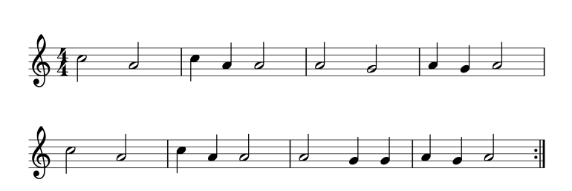
Indian Chant
CD #8
Purple Belt
mf
--mezzoforte, medium loud
American
4-A
4-B
4-C
5-A
5-B
5-C

Slide 19
Rockin’
Blue Belt
I use songs from many different resources. While I do have the rights to use these songs in the classroom, I do not have the rights to post them online. This song has not been posted due to copyright.
4-A
4-B
4-C
5-A
5-B
5-C

Slide 20

Polka Dot Polka
CD #11
Practice
I use songs from many different resources. While I do have the rights to use these songs in the classroom, I do not have the rights to post them online. This song has not been posted due to copyright.
4-A
4-B
4-C
5-A
5-B
5-C

Slide 21
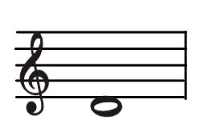
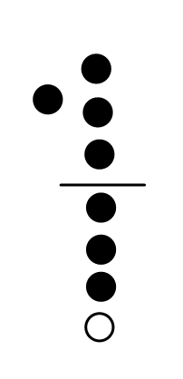
Fingering: Low D
Memorize your fingerings

Slide 22
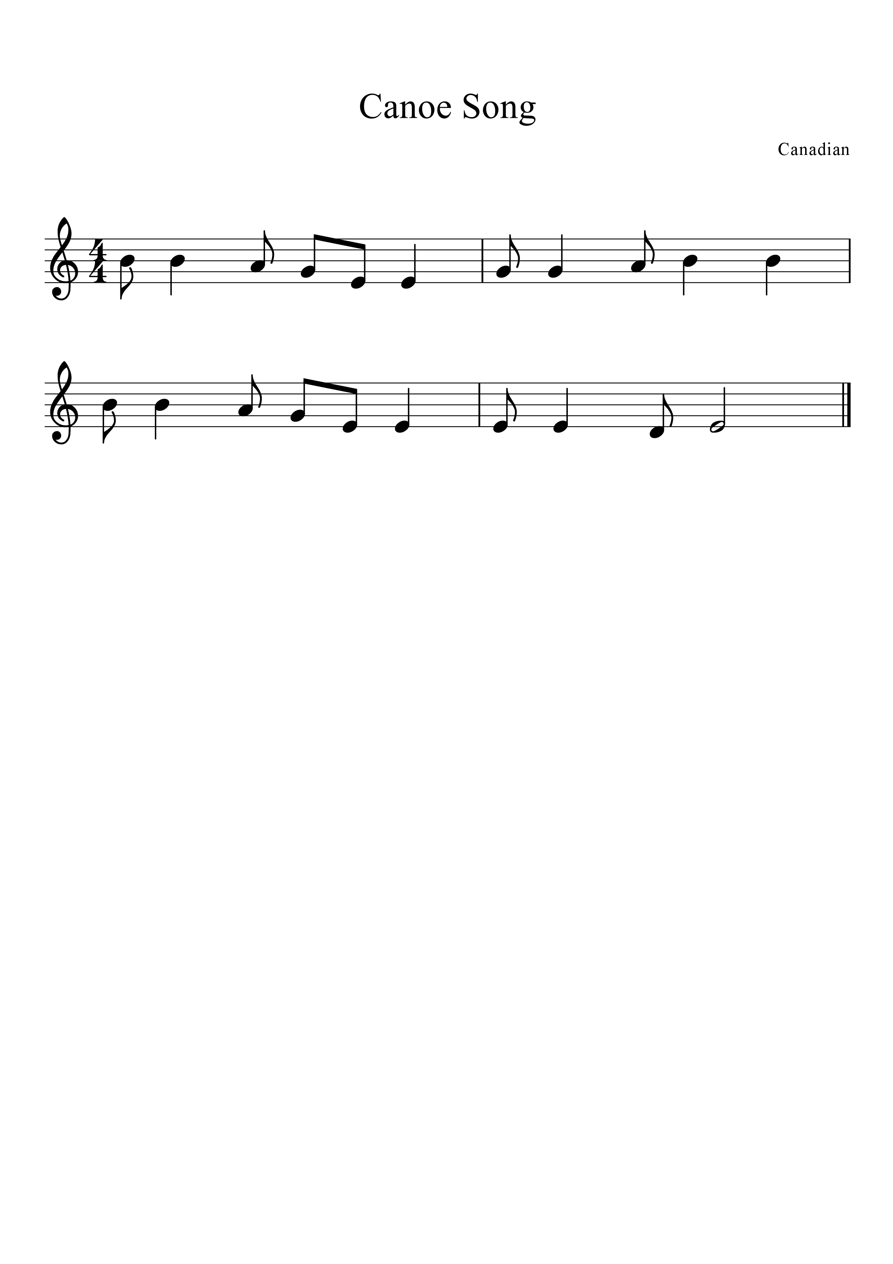
Canoe Song piano acc.
syn - co - pa
** Have your right hand ready.
Seat your fingers down to D.
Green Belt
Canadian
4-A
4-B
4-C
5-A
5-B
5-C

Slide 23

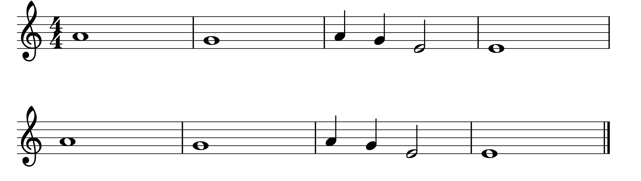
Indian Dance
CD #30
Practice
** Have your right hand ready.
Seat your fingers down to E.
American
mp
----mezzopiano, medium soft
4-A
4-B
4-C
5-A
5-B
5-C

Slide 24
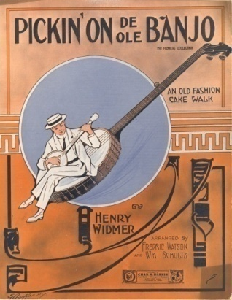
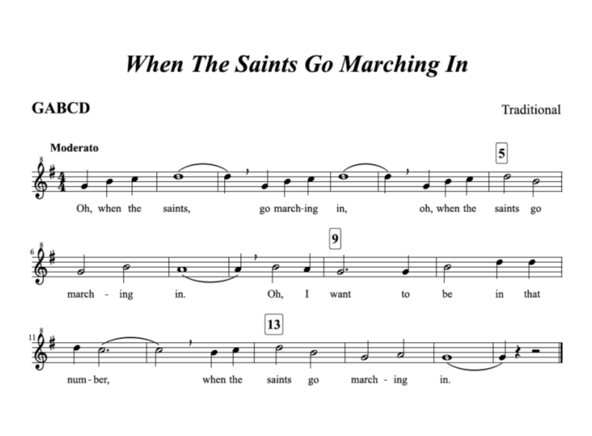
When the Saints
Brown Belt
4-A
4-B
4-C
5-A
5-B
5-C

Slide 25
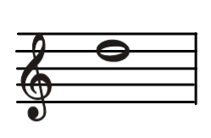
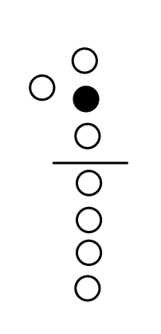
Fingering: High D
Memorize your fingerings

Slide 26
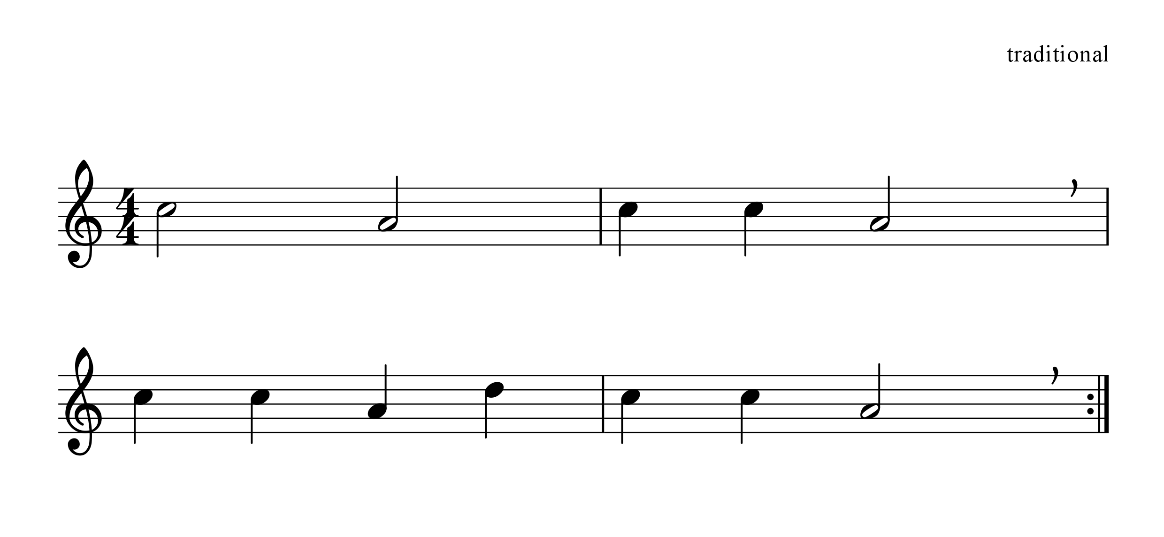
Rain, Rain Go Away
CD #12
Practice
mp
--mezzopiano, medium soft
4-A
4-B
4-C
5-A
5-B
5-C

Slide 27
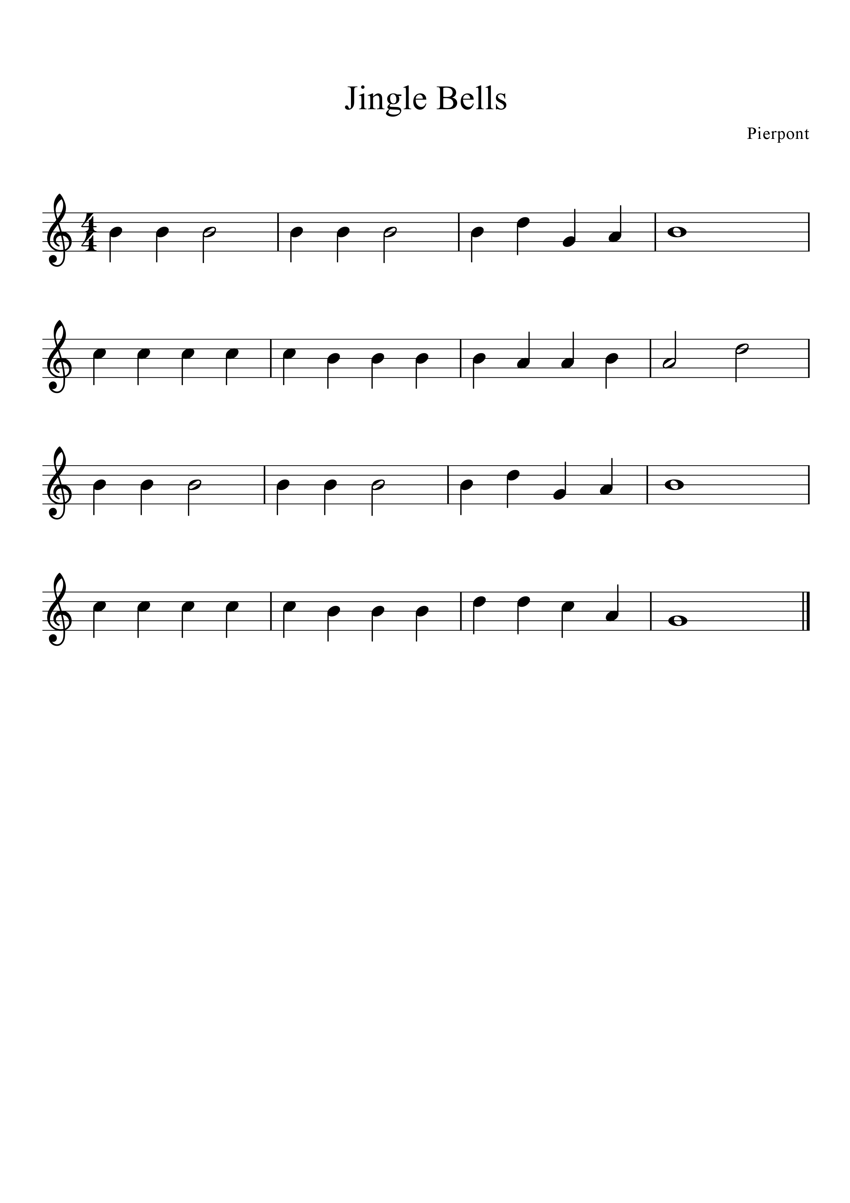
Jingle Bells
CD #15
Red Belt
Pierpont
4-A
4-B
4-C
5-A
5-B
5-C

Slide 28
Dotted Rhythms
Review
=
dotted quarter note =
1 ½ beats
=
eighth note =
½ beat
tim re

Slide 29
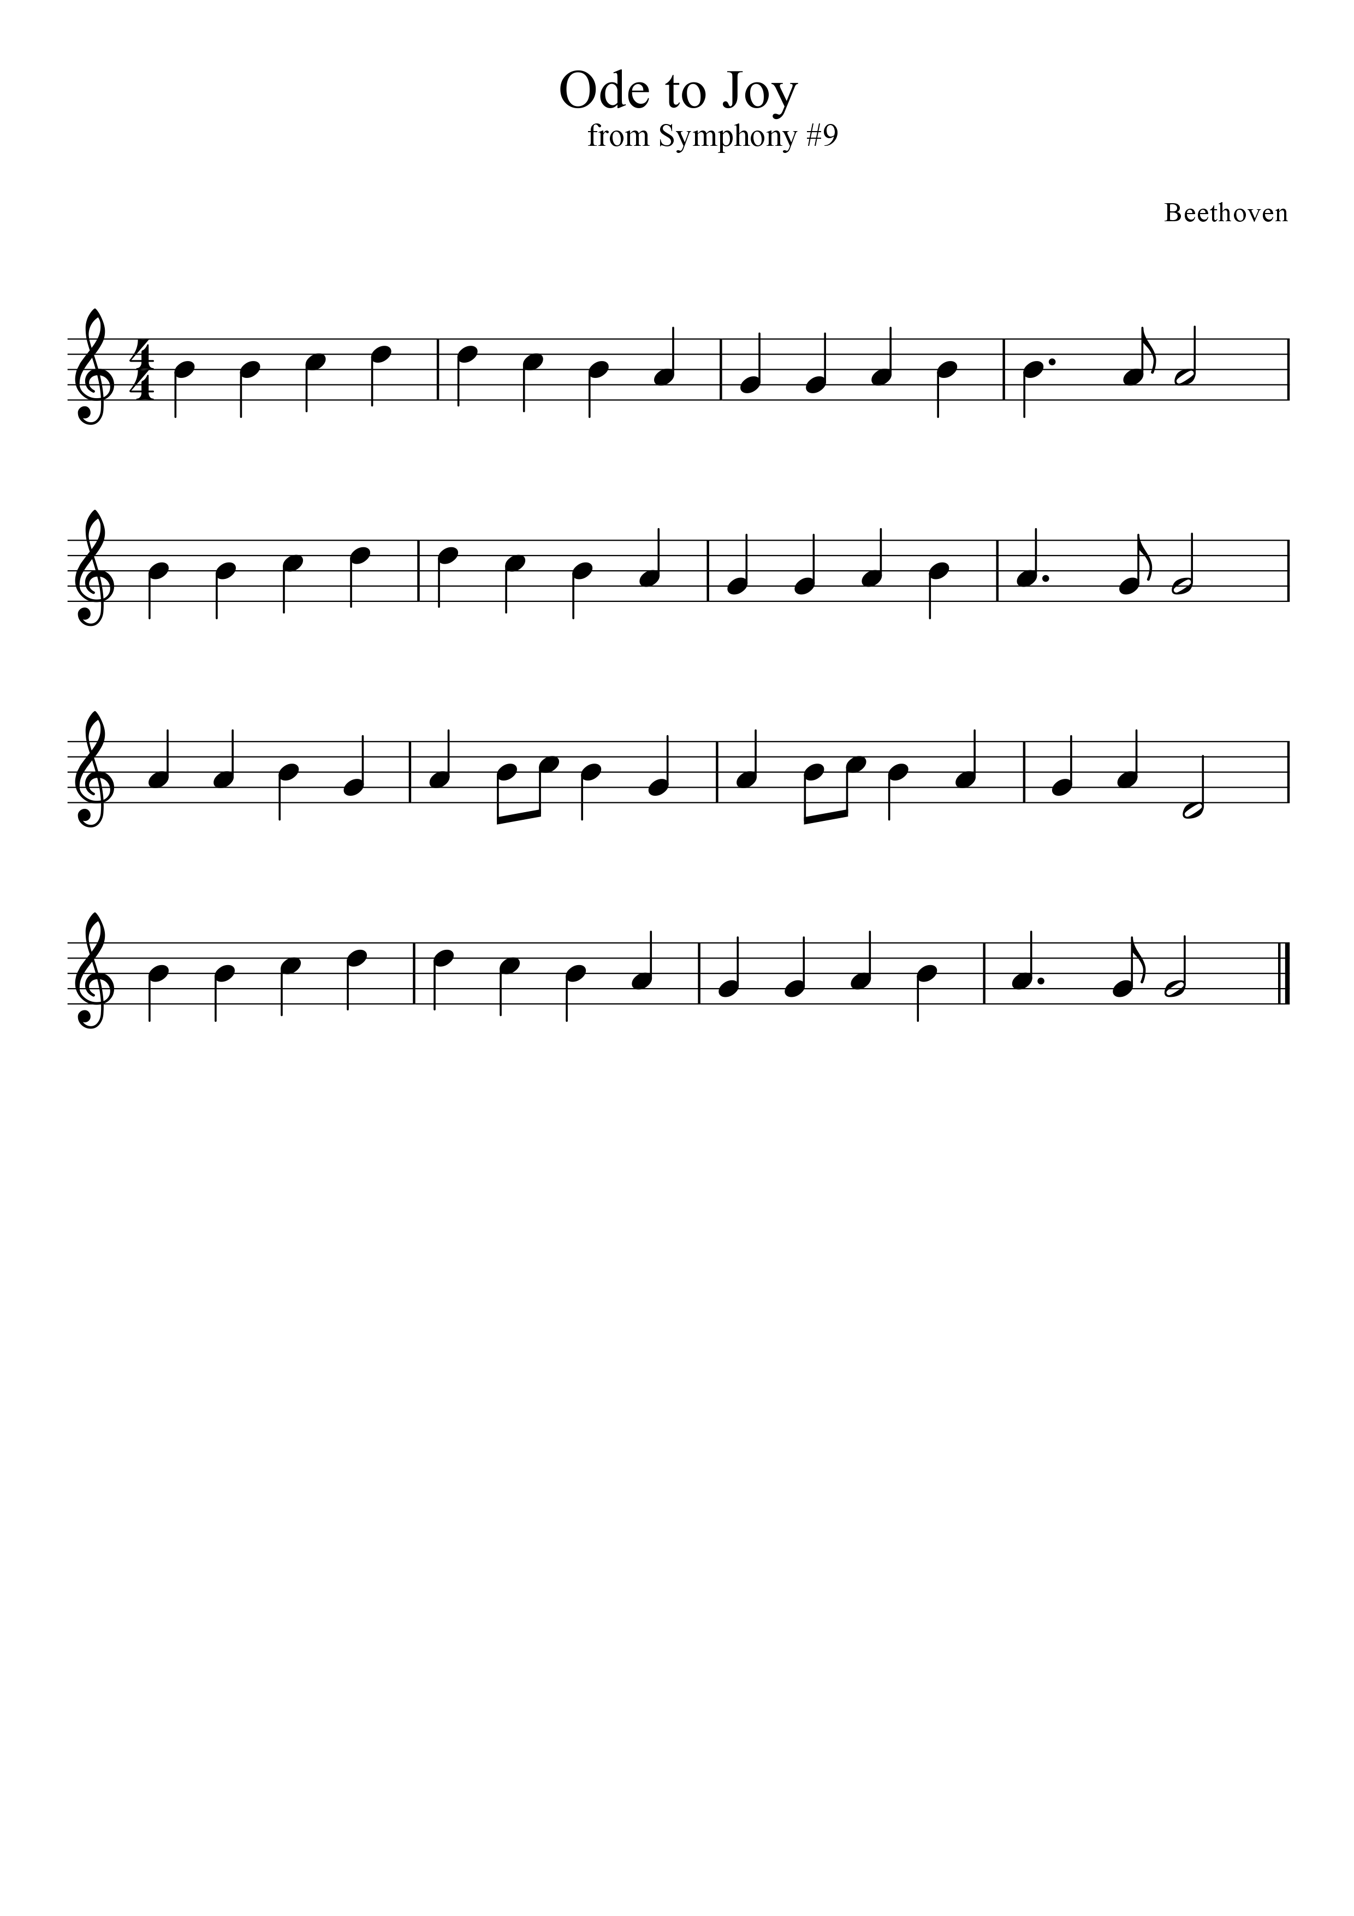
Ode to Joy
CD #49
** Have your right hand ready. Seat your fingers down to D.
Black Belt
Beethoven
4-A
4-B
4-C
5-A
5-B
5-C
Finger
& sing

Slide 30
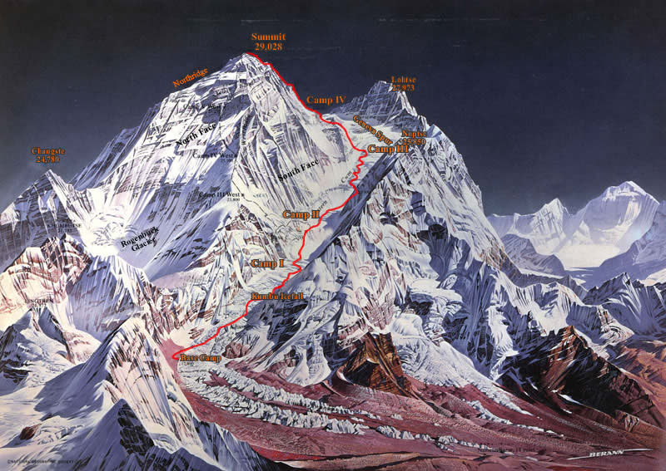
Challenge Songs

Slide 31
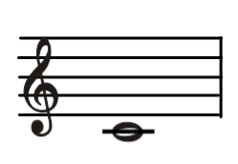
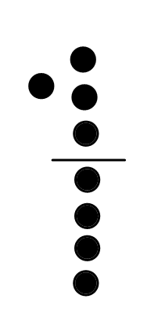
Fingering: Low C
Memorize your fingerings

Slide 32
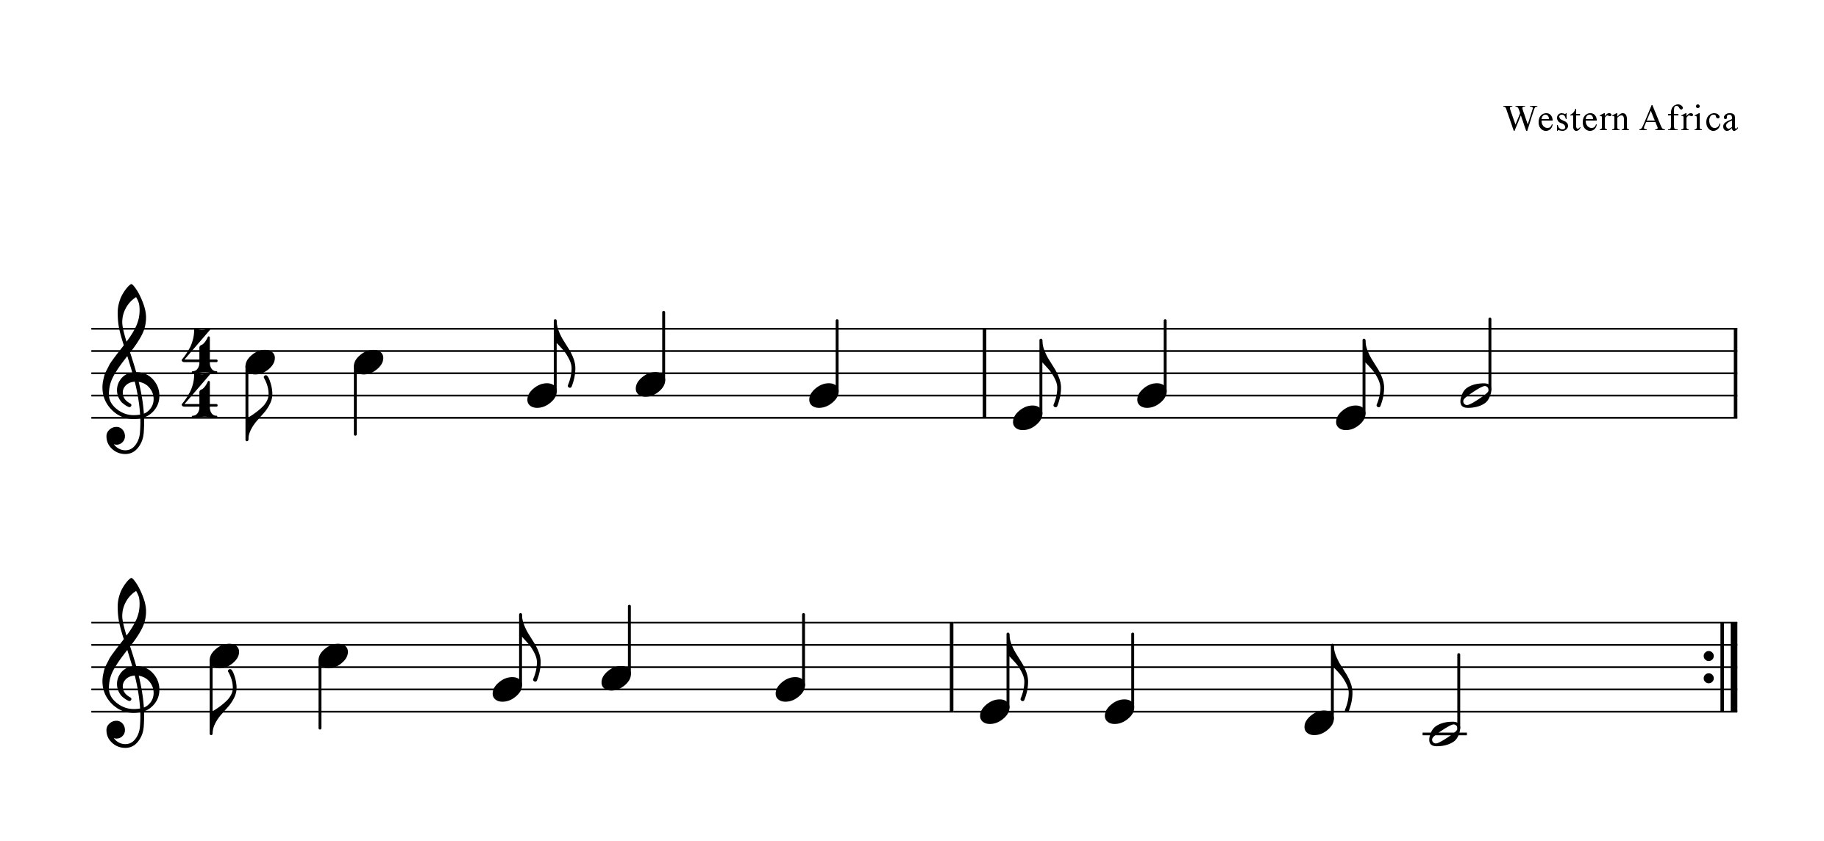

Fun wa nia ala fia
piano acc.
syn - co - pa
1
Challenge
Bead
** Have your right hand ready. Seat your fingers down to C.
Sing in Swahili 4xs
Play 2xs
Sing in English 4xs
Play 2xs
5-A
5-B
5-C

Slide 33
Ornaments
Music from the Baroque and Classical periods often contain many different types of ornaments.
trills—rapidly play from written note to one note higher.
turns—play written note then, one note higher, written
note and then one note lower, back to original note.
grace notes—rapidly play first note resting on
second note.
mordents—play written note, then rapidly one note
higher, then back to original note.

Slide 34

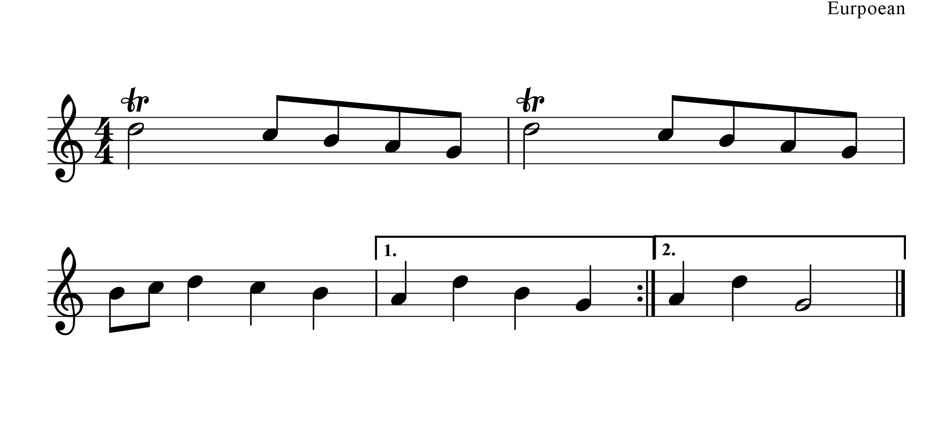
Baroque Recorder Piece
piano acc.
2
Challenge
Bead
Baroque architecture was filled with ornaments and decorations as was the music of the time period.
tr.
tr.
5-A
5-B
5-C
Finger
& sing

Slide 35
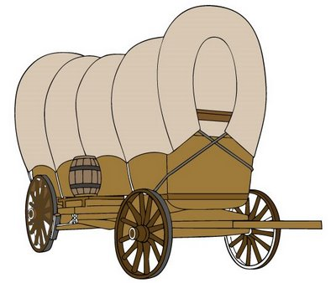
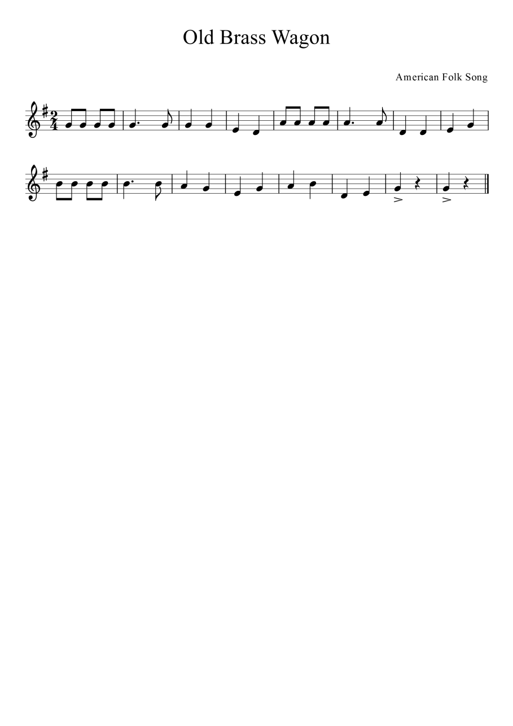
Old Brass Wagon
#45
3
Challenge
Bead
** Have your right hand ready.
Seat your fingers down to D.
>
--accent, play a little louder.
5-A
5-B
5-C

Slide 36
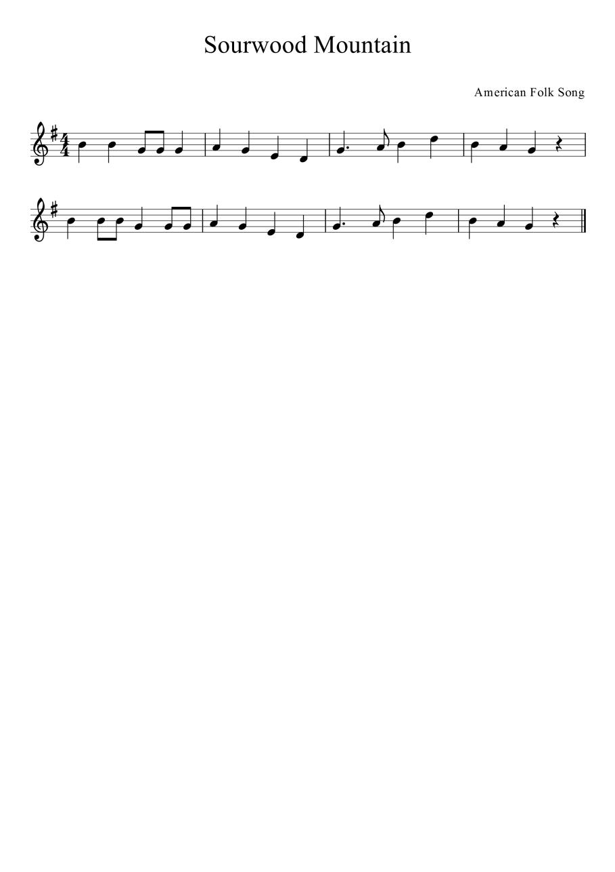
Sourwood Mountain
#46
4
Challenge
Bead
** Have your right hand ready.
Seat your fingers down to D.
5-A
5-B
5-C

Slide 37
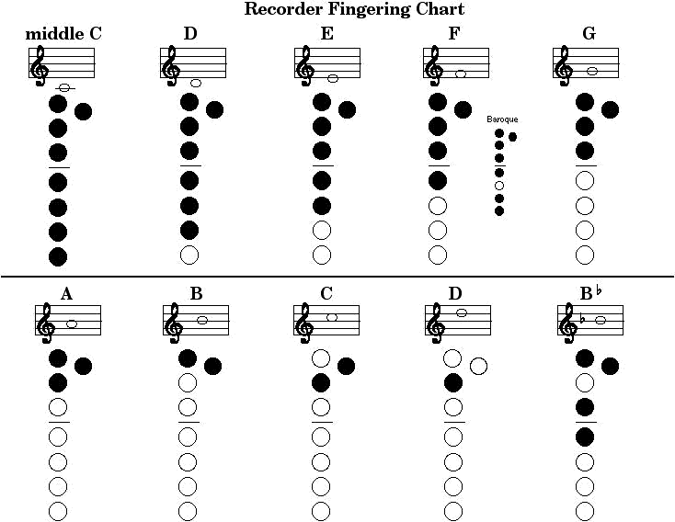
Memorize your fingerings
Notice: Many fingering charts will be have a slightly different format. This chart has the thumb hole on the opposite side.

Slide 38
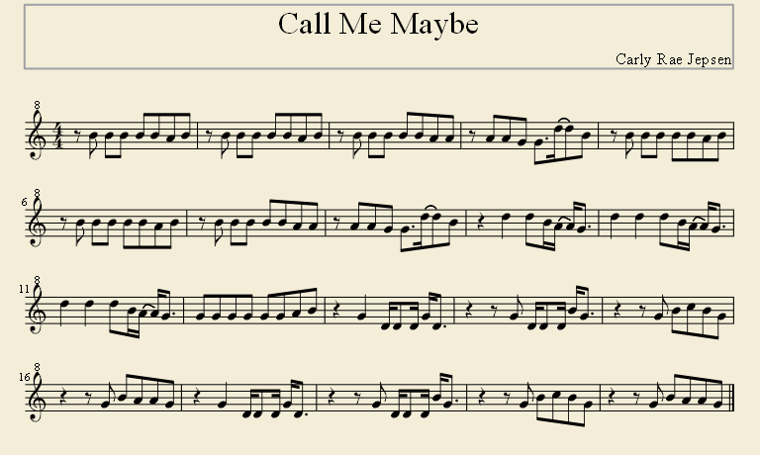
Official Video
https://www.youtube.com/watch?v=RWAdb1vgoik
Mrs. Jean:
https://www.youtube.com/watch?v=_QRtF7CrC5Y

Slide 39
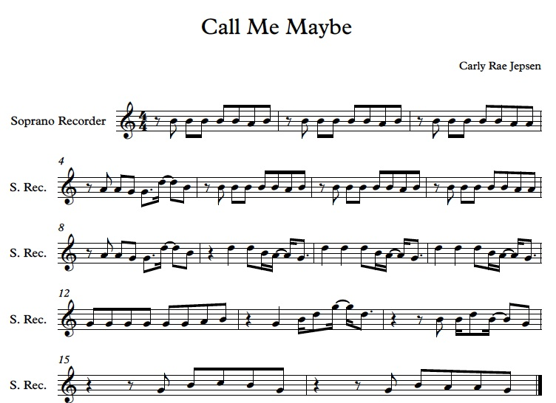
Official Video
https://www.youtube.com/watch?v=RWAdb1vgoik
Mrs. Jean:
https://www.youtube.com/watch?v=_QRtF7CrC5Y

Slide 40
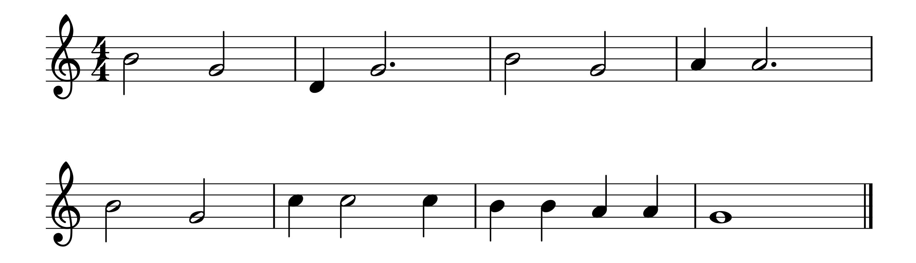
Good Night Ladies
CD #36
Brown Belt
** Have your right hand ready.
Seat your fingers down to D.
4-A
4-B
4-C
5-A
5-B
5-C

Slide 41
Beginning Rotation

Slide 42
Recorder Karate
White Belt
Red Belt
Yellow Belt
Black Belt
Orange Belt
1
Challenge
Bead
Purple Belt
2
Challenge
Bead
Blue Belt
3
Challenge
Bead
Green Belt
4
Challenge
Bead
Brown Belt
**Classroom chart to track belts **Smart Response test

