Slide 1
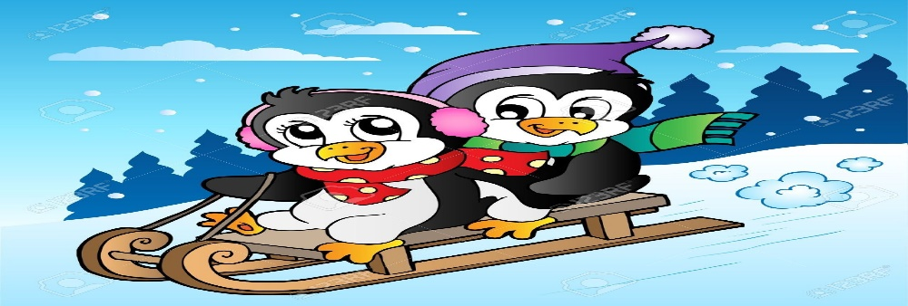
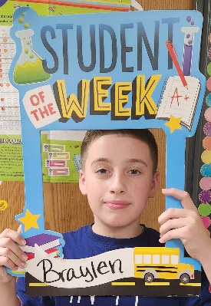
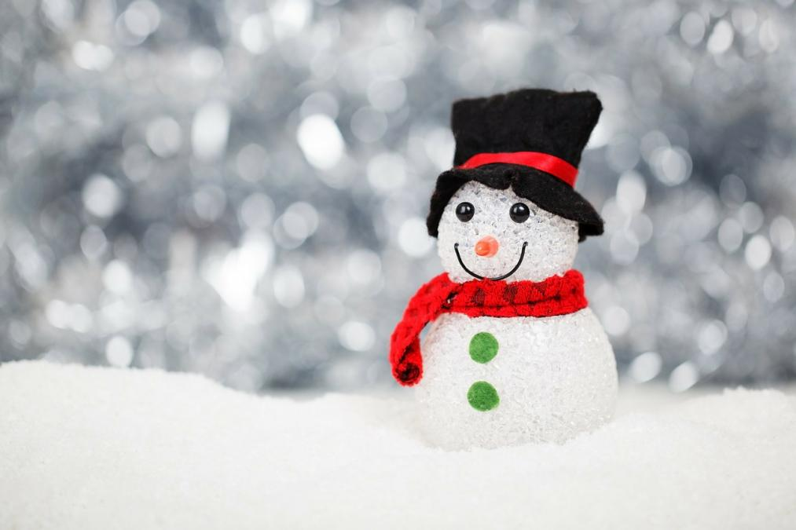
Ms. S’ Class
Classroom Newsletter
December 12th –16th, 2022
Dates to Remember This Week
Dec 12th: Holiday Traditions
Dec 13th: Winter Wonderland
Dec 14th: Elves, Reindeer, and Snowmen. Oh, my!
Dec 15th: Hats off to the Holidays
Dec 16th- Long Winter’s Nap
Classroom News
Happy weekend! We are now finished with our fourteenth week of school! I hope you all had a great weekend!
We have finished drafting our biographies and will begin revising them this week. We are learning about the Biosphere this week and how climate affects us. We are also continuing to learn how to add and subtract decimals.
Next week we will take our end of the unit math test, so please be on the lookout for a review packet to come home on Thursday night.
Have a great weekend!
Student of the Week
Braylen Copeland
Braylen is a very polite student. He is very caring and compassionate to those around him and is a great friend. Braylen is always willing to help when needed.
Ms. S’ Class Email address: erika.smith@jcschools.us
Lawson Elementary School Website: https://www.jcschools.us/Page/19654 1105 Fairgrounds Rd Phone Number: 573-691-3175

Slide 2
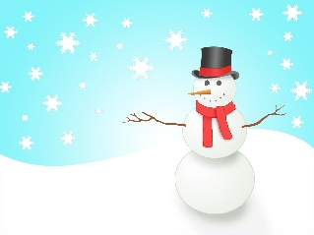
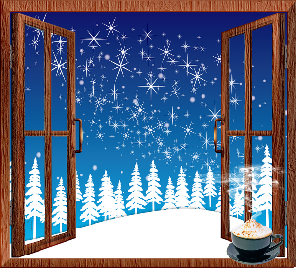
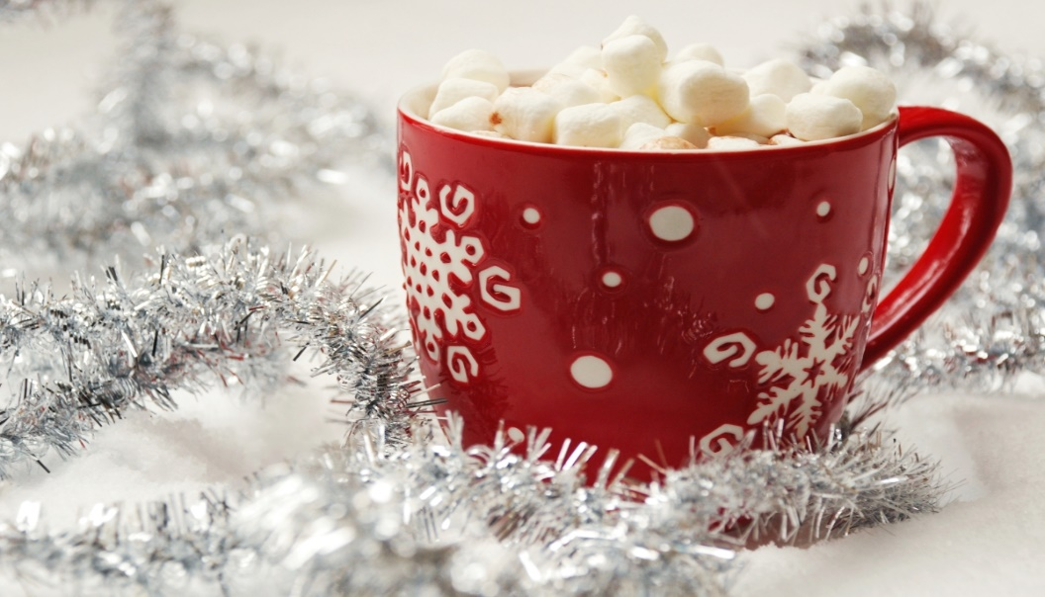
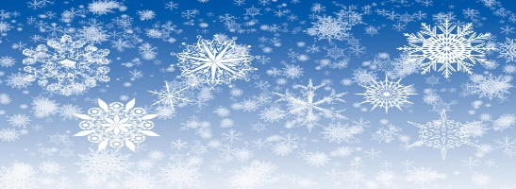
Breakfast Menu
Monday: Mini Cinnis
Tuesday: Pizza Bagel
Wednesday: Cereal Variety
Thursday: Tornado Variety
Friday: Cereal Variety
What We’re Learning Next Week
Reading: Informative texts
Writing: Writing to inform
Math: Decimals
Science: Interactions of Earth’s major systems
Social Studies: The road to the Civil War
Reminders
Holiday Spirit Days are December 12-21!
Dec 21st: 3 Hour Early Release
Dec 22nd- Jan 2nd: Winter Break
Don’t forget to sign your child’s reading log daily!
Lunch Menu
Monday: Ravioli
Tuesday: BBQ Chicken Sandwich
Wednesday: Brunch Lunch
Thursday: Pigs in a Blanket
Friday: Pizza

Slide 3
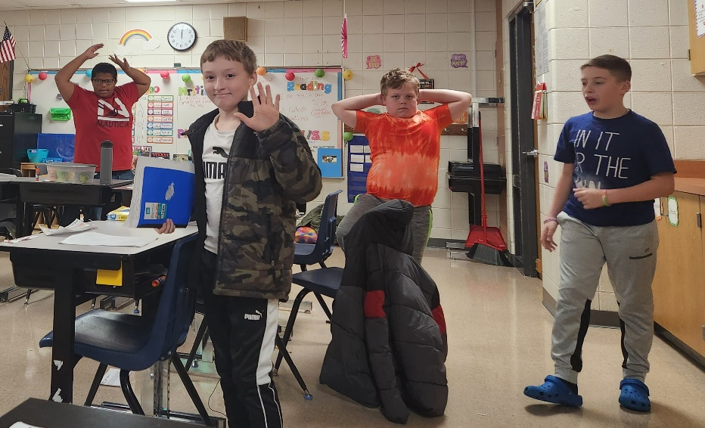
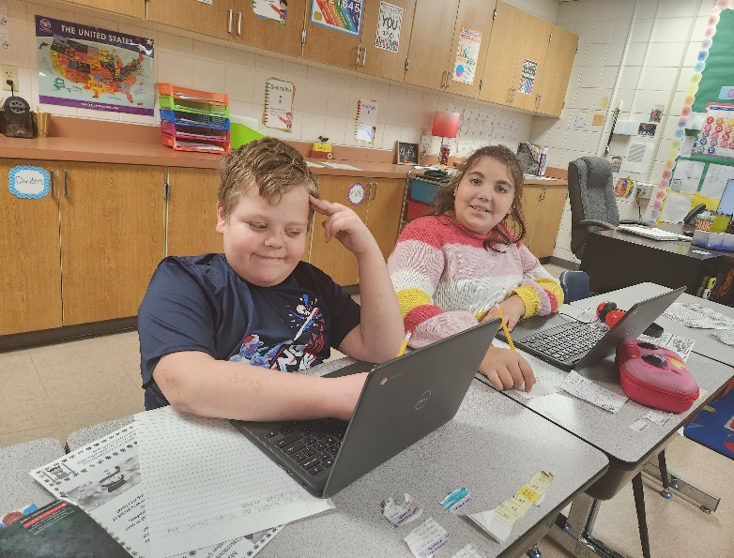
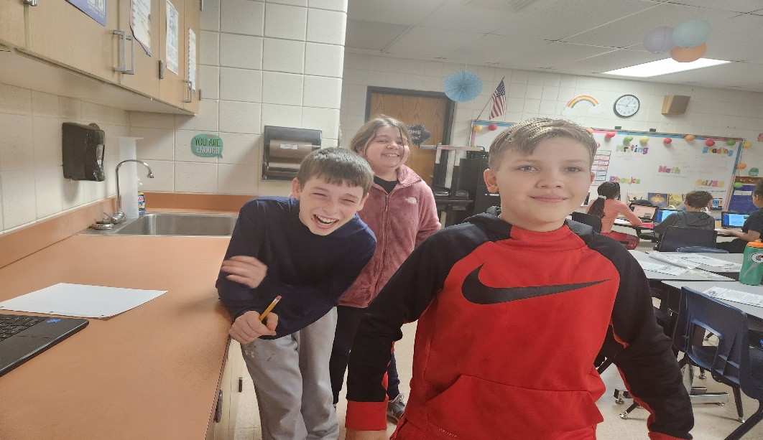
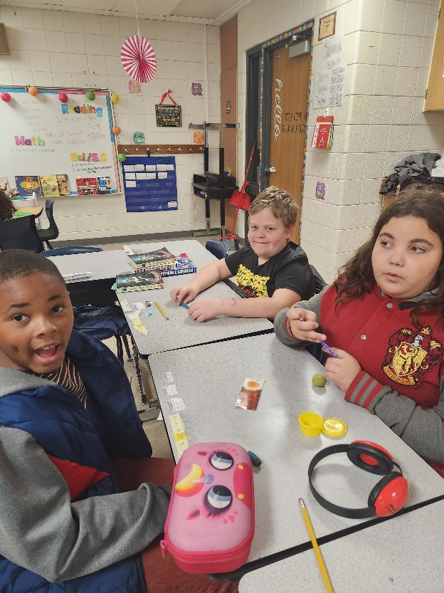
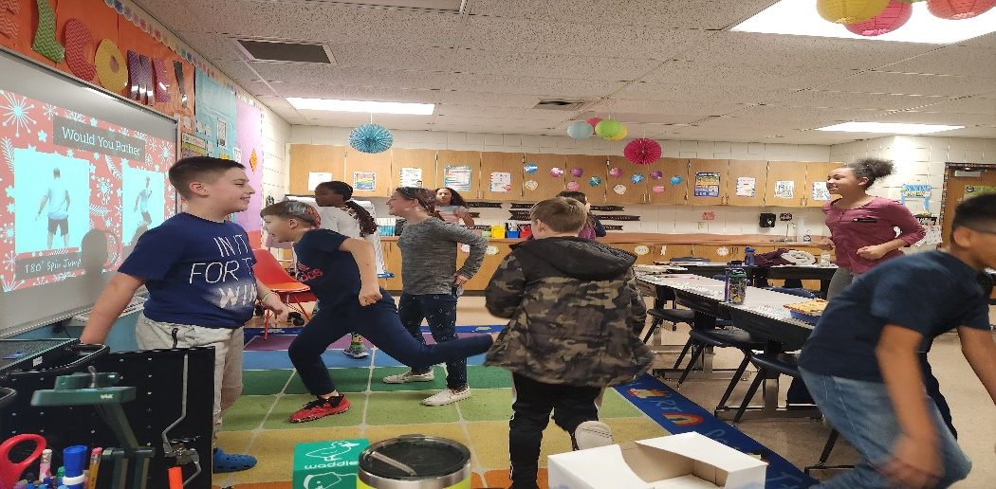
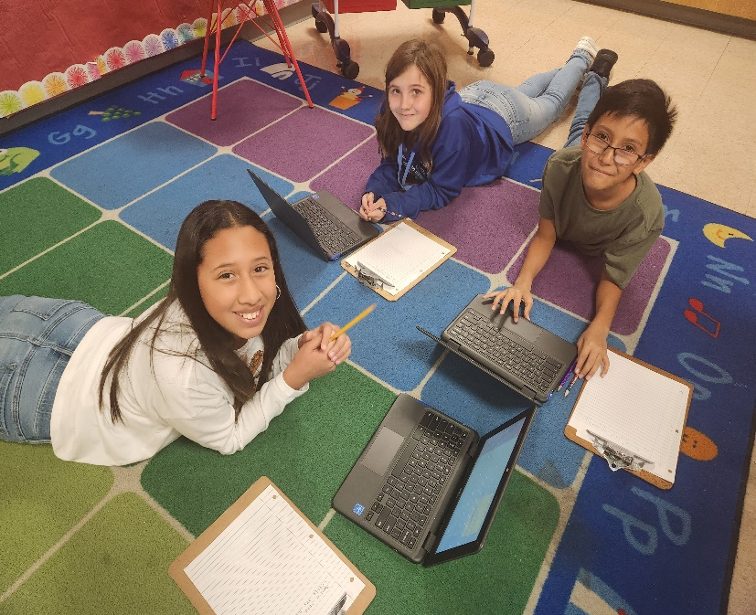
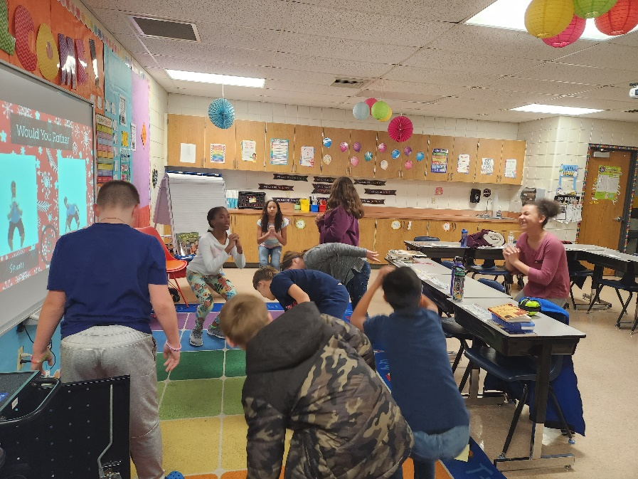
Some highlights from our week!

