Slide 1
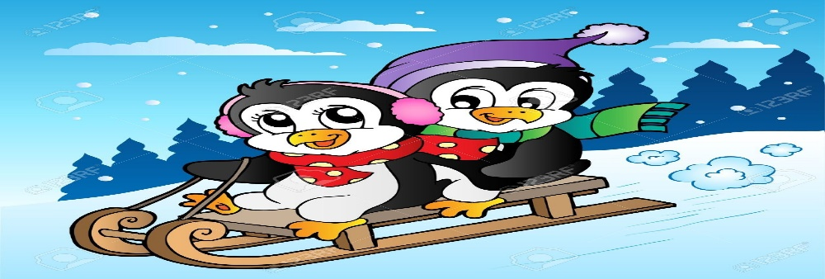
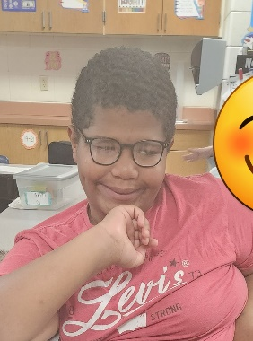
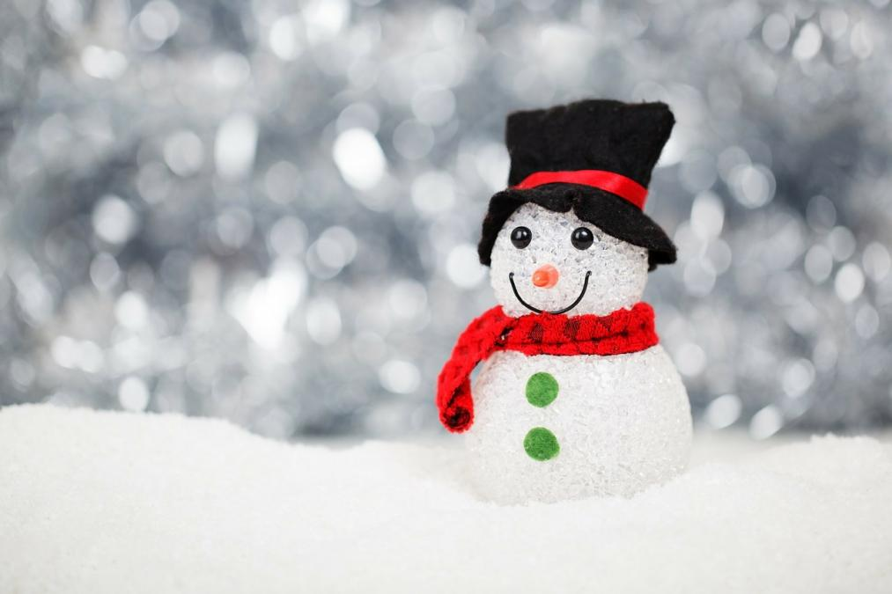
Ms. S’ Class
Classroom Newsletter
December 19th-21st 2022 and January 3^{rd- 6th}, 2023
Dates to Remember This Week
Dec 22nd- Dec 2nd: Winter Break
Dec 3rd: First day back from break
Classroom News
Happy weekend! We are now finished with our sixteenth week of school! I hope you all had a great weekend!
We have begun publishing our biographies. We finished our unit on adding and subtracting decimals and did awesome on the test!
I hope you all have a wonderful time with friends and family over this holiday break! I hope your New Years is a great one, and I can’t wait to see everyone back in 2023!
Have a great holiday break!
Student of the Week
Jackson Miller
Jackson is an awesome student! He is always so happy to be in class and brings a smile to everyone’s faces. He is a great friend and always up for a challenge.
Ms. S’ Class Email address: erika.smith@jcschools.us
Lawson Elementary School Website: https://www.jcschools.us/Page/19654 1105 Fairgrounds Rd Phone Number: 573-691-3175

Slide 2
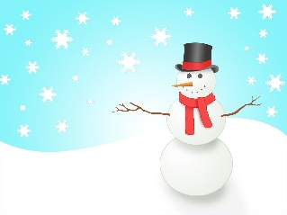
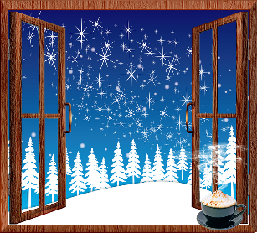
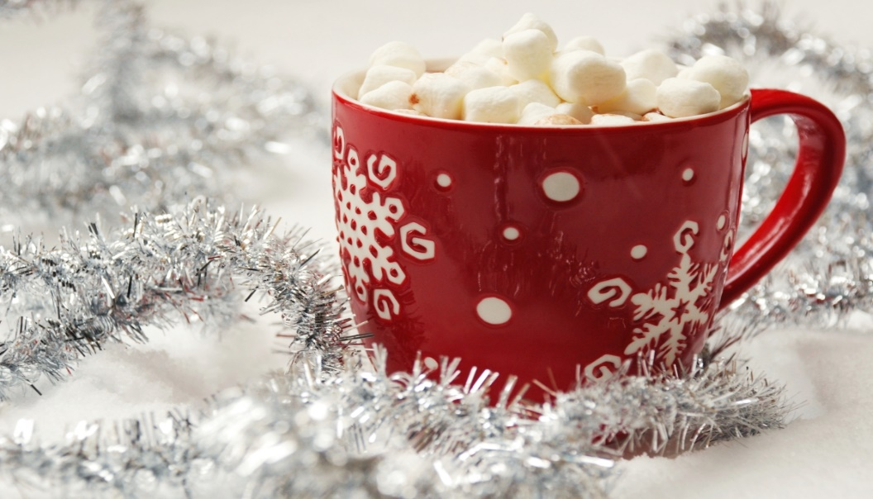
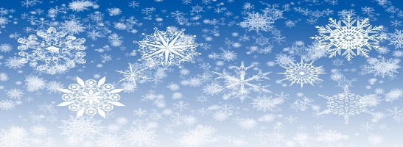
Breakfast Menu
Monday:
Tuesday:
Wednesday:
Thursday:
Friday:
What We’re Learning Next Week
Reading: Informative texts
Writing: Writing to inform
Math: Multiplying Decimals
Science: The Solar System & Beyond
Social Studies: Geography: Human Environment, Interactions, & Economics
Reminders
Dec 22nd- Jan 2nd: Winter Break
Don’t forget to sign your child’s reading log daily!
Lunch Menu
Monday:
Tuesday:
Wednesday:
Thursday:
Friday:

Slide 3
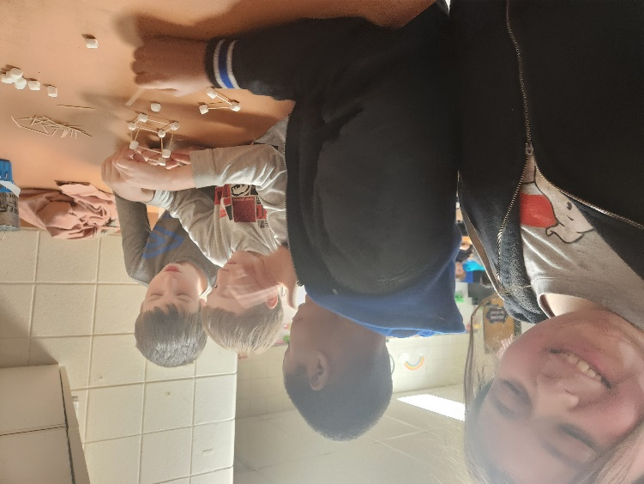
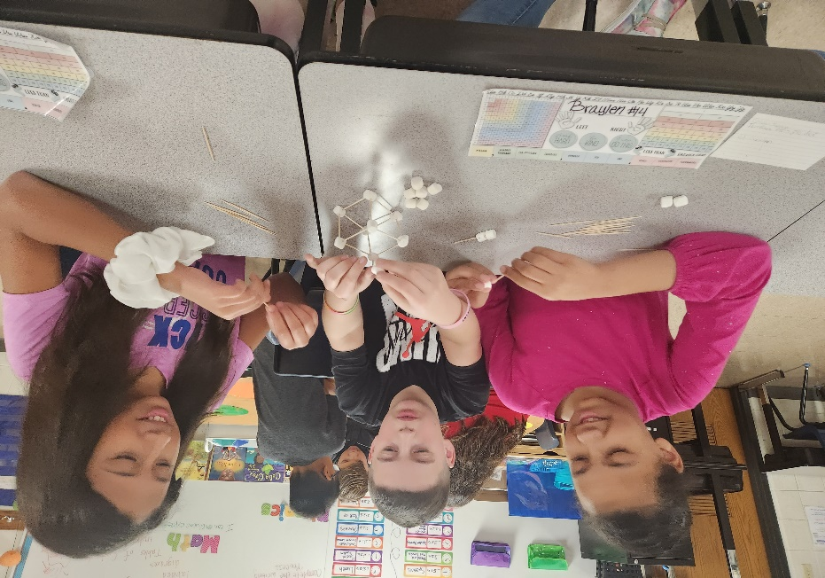
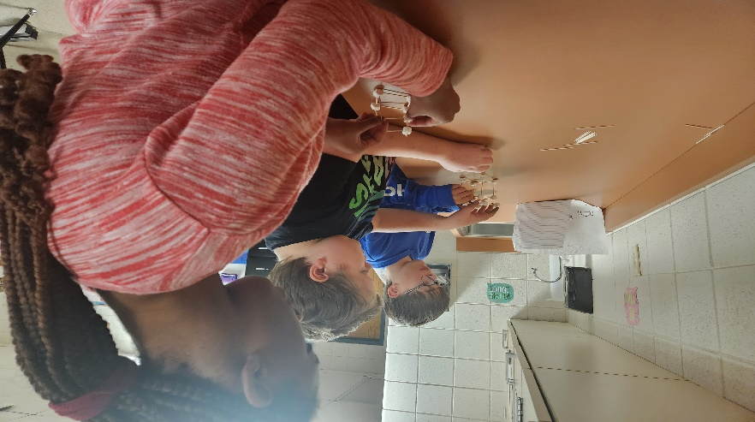
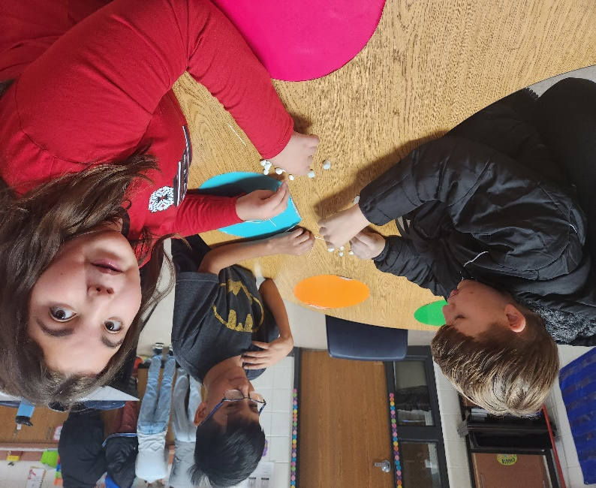
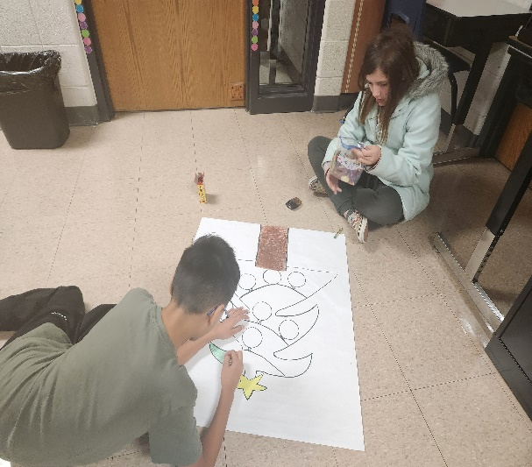
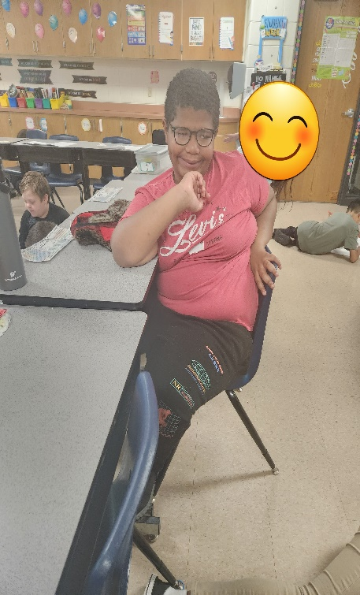
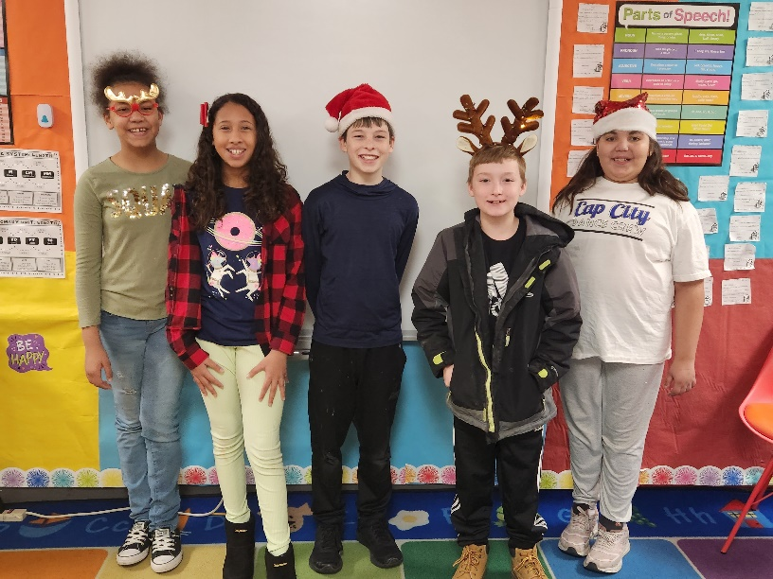
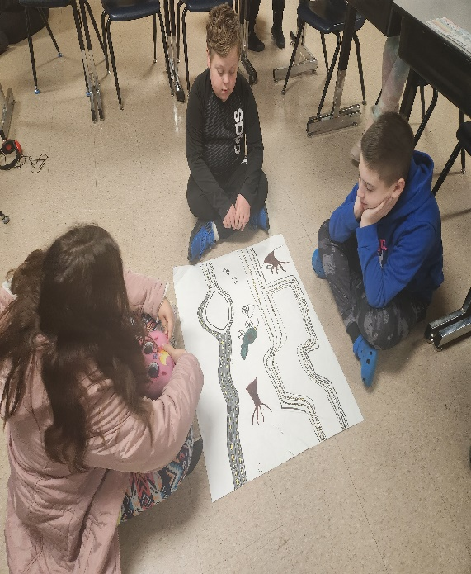
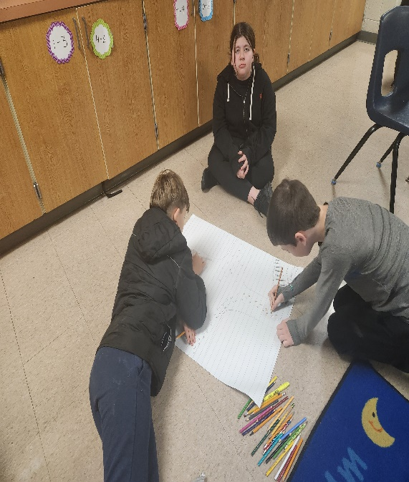
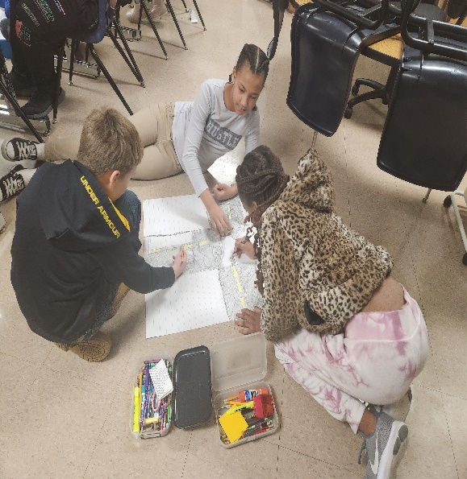
Some highlights from our week!

